Slide 1

PROJECT REVIEW
Kenny Power
Matthew Brousseau
Miria Rafante

Slide 2

PROJECT
We chose to do the sound classification task from Kaggle [1] (offered to the class as an option)
[1] General-purpose Audio Tagging of Freesound Content with AudioSet Labels - DCASE. (n.d.). Retrieved July 19, 2018, from http://dcase.community/challenge2018/task-general-purpose-audio-tagging

Slide 3
SOUND PROPERTIES
What causes the different sounds?
The differences are caused between intensity, pitch, tone [1]
Librosa package has several functions that extract sounds properties that includes in the baselines the properties above
Source: https://www.nde-ed.org/EducationResources/HighSchool/Sound/components.htm

Slide 4
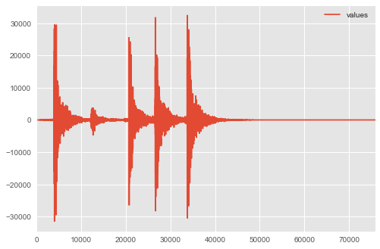
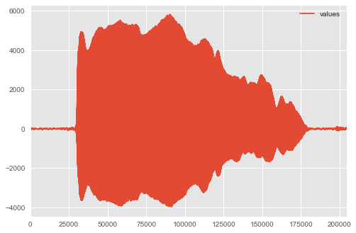
EXTRACTING FEATURES:
Plotting a Knock sound sample. The x-axis is time in ms.
Plotting a Oboe sound sample. The x-axis is time in ms.

Slide 5
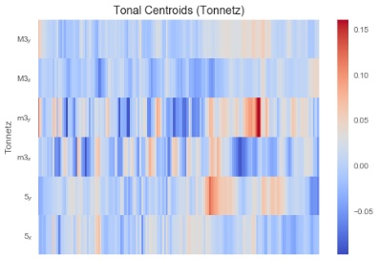
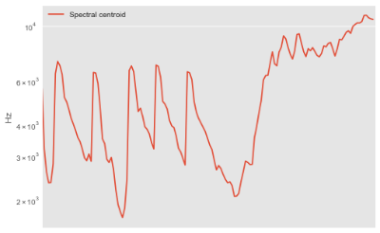
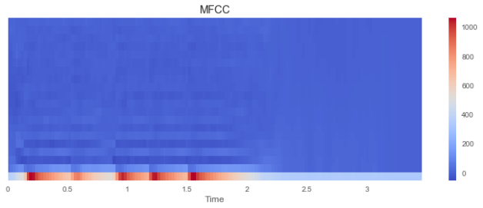
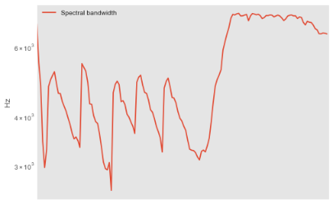
EXTRACTING FEATURES:
Plotting a Knock sound sample. The x-axis is time in ms.
Feature extracted: (top-left) Tonnetz, (top-right) Spectral centroid, (bottom-left) MFCC and (bottom right) Spectral bandwidth.

Slide 6
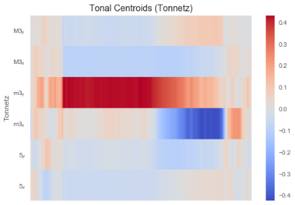
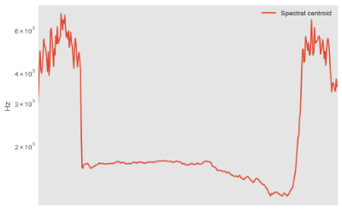
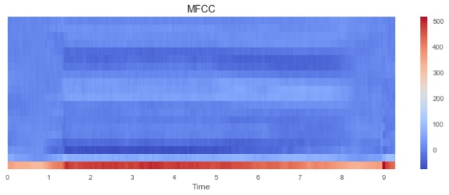
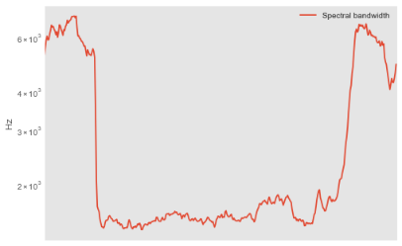
EXTRACTING FEATURES:
Plotting a Oboe sound sample. The x-axis is time in ms.
Visualization of the oboe sample trough some librosa's functions for feature extraction: (top-left) Tonnetz, (top-right) Spectral centroid, (bottom-left) MFCC and (bottom right) Spectral bandwidth. Source: https://librosa.github.io/librosa/index.html

Slide 7
EXTRACTING FEATURES:
Knock Oboe
Visualization of the know sample trough some librosa's functions for feature extraction: (top-left) Tonnetz, (top-right) Spectral centroid, (bottom-left) MFCC and (bottom right) Spectral bandwidth. Source: https://librosa.github.io/librosa/index.html
Visualization of the oboe sample trough some librosa's functions for feature extraction: (top-left) Tonnetz, (top-right) Spectral centroid, (bottom-left) MFCC and (bottom right) Spectral bandwidth. Source: https://librosa.github.io/librosa/index.html

Slide 8
COMPARING FEATURE EXTRACTED FOR CLASSIFICATION:
Data description | MaxSize | RF – 3-fold
Tone | 1000 | Scores: [0.2971246, 0.31012146, 0.29681112] Mean: 0.30135239277503162 Std: 0.0062019856754040002
Spectral Centroid | 1000 | Scores: [0.43210863, 0.43724696, 0.4480785] Mean: 0.4391446950878993 Std: 0.006656336335106039
Spectral Bandwidth | 1000 | Scores: [ 0.44888179, 0.43076923, 0.43254293] Mean: 0.4373979823782462 Std: 0.008152499127789991
MFCC | 1000 | Scores: [0.64616613, 0.65101215, 0.65494685] Mean: 0.65070837731252074 Std: 0.0035911426034004267

Slide 9
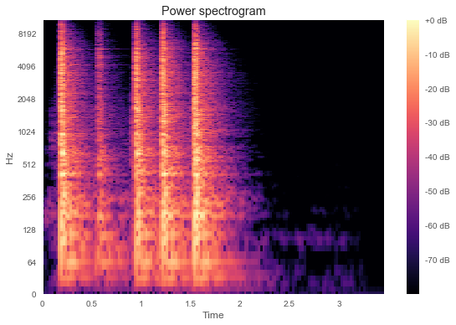
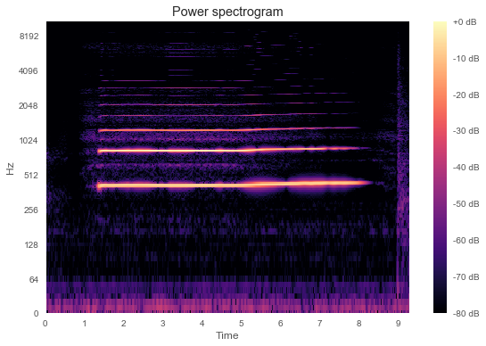
EXTRACTING FEATURES: SFTF
Knock Oboe
Power spectrograms of a Knock and an Oboe sound samples, respectively. Dimensions: 1025 frequencies x time x intensity at each time-frequency point.

Slide 10
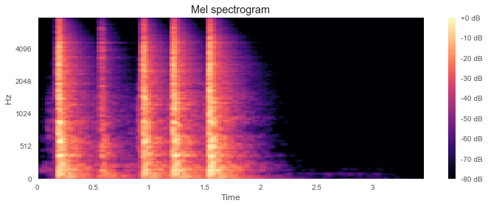
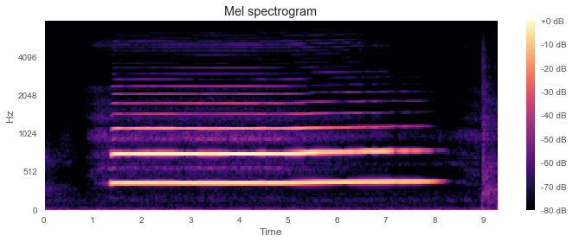
EXTRACTING FEATURES: MEL-SPECTOGRAM
Knock Oboe
Mel spectrograms of a Knock and an Oboe sound samples, respectively. Dimensions: 128 frequencies x time x intensity at each time-frequency point.

Slide 11
COMPARING FEATURE EXTRACTED FOR CLASSIFICATION:
Data description | MaxSize | RF – 10-fold
MFCC | 1000 | Scores: [0.67792208, 0.66318538, 0.67810026, 0.63852243, 0.7037037, 0.67204301, 0.67847411, 0.66111111, 0.64145658, 0.69714286] Mean: 0. 67116615275898628 Std: 0. 019986117622205764
SFTF | 1000 | Too many dimensions caused the computers to crash.
Mel-spectrogram | 1000 | Scores: [ 0.65454545, 0.64490862, 0.6701847 , 0.63060686, 0.67195767, 0.64516129, 0.63760218, 0.63333333, 0.60784314, 0.68285714] Mean: 0.64790003830238196 Std: 0.021400537162279857

Slide 12


SIGNAL PROCESSING
Before feeding the data into the model, we need to make it useful!
We only do MFCC by hand as it was our best performer
Notes:
As we seen earlier we tried many different types of data transformations. MFCC was consistently the best performer for us. Librosa did not have great documentation on how exactly they get their MFCCs, and I came across some resources which went through this process. For this project, I just implemented the MFCC to see if it would help being able to tweak things as we liked.

Slide 13
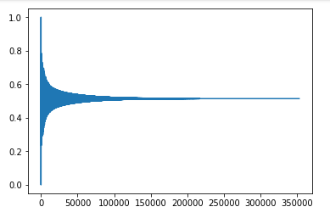
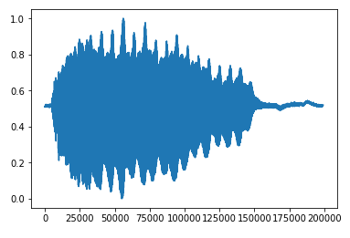
SIGNAL PROCESSING - (NORMALIZED) WAVES
Notes:
Before we start working with our data, we first normalize it!

Slide 14
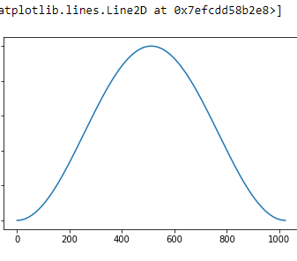
SIGNAL PROCESSING - AUDIO FRAMING
Notes:
Because audio is a non stationary process, the FFT (Fast fourier transform) will produce distortions. To overcome this we can assume that the audio is a stationary process for a short periods of time. Because of that we divide the signal into short frames. Each audio frame will be the same size as the FFT. Also we want the frames to overlap. We do that so that the frames will have some correlation between them and because we lose the information on the edges of each frame after applying a window function.

Slide 15
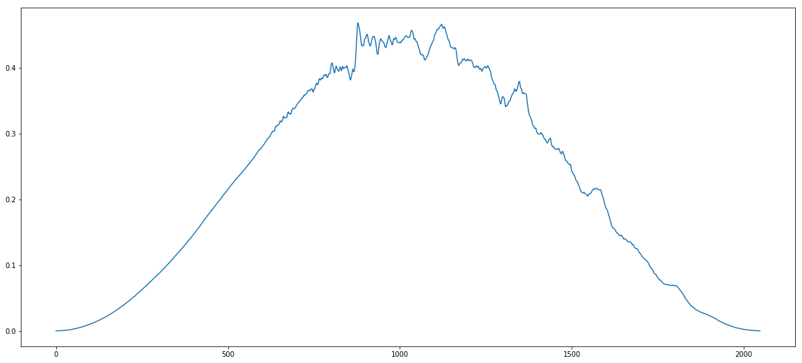
SIGNAL PROCESSING - FRAMED AUDIO IN FREQUENCY DOMAIN
Notes:
This is to show how the framed audio looks

Slide 16
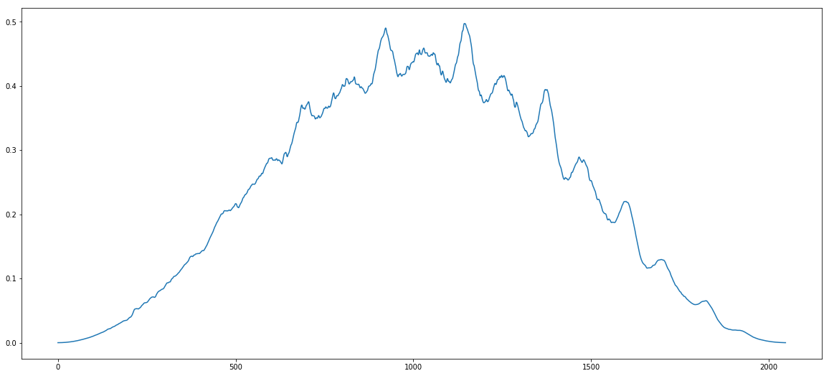

Slide 17
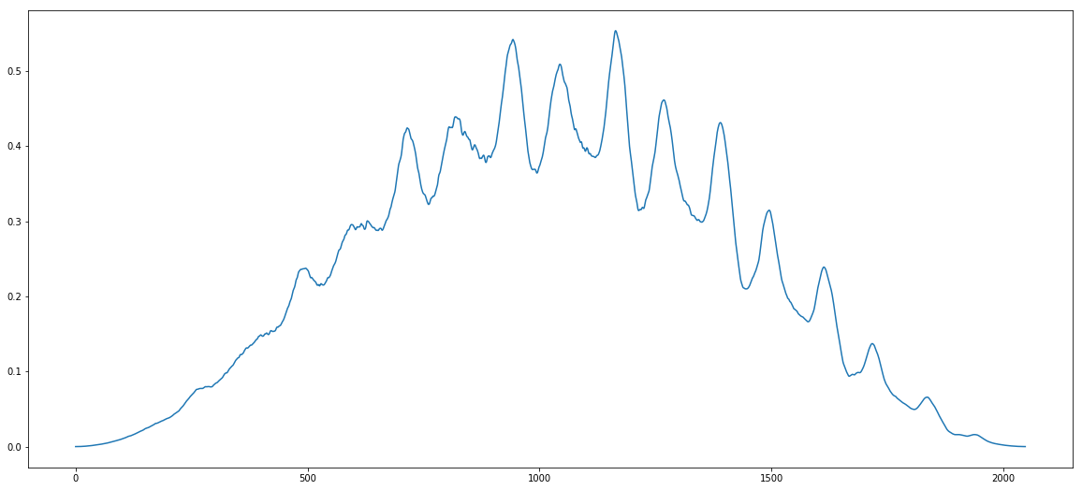

Slide 18
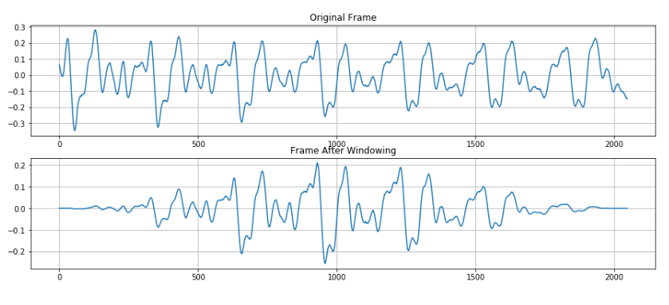
SIGNAL PROCESSING - AFTER ‘WINDOWING’
(Image from https://www.kaggle.com/ilyamich/mfcc-implementation-and-tutorial)

Slide 19
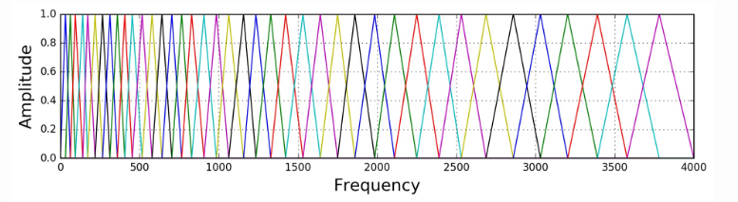
SIGNAL PROCESSING - FILTER BANKS
(From https://haythamfayek.com/2016/04/21/speech-processing-for-machine-learning.html )
Notes:
After the data has been framed, we do a N-point FFT to get the frequency spectrum and then compute the power spectrum. Following this, we compute filter banks on the mel-scale and then apply the filter banks to the power spectrum! This is how we get our melspectrograms. This was a late idea so I didnt get to play with parameters much at all, but it did not seem to give any significant improvements on our results unfortunately, but I think it certainly would be useful to have for future work if we had a good understanding of processing signals and knew what to look for and such. It could help us achieve better MFCCs and other coefficients.

Slide 20
HOW TO FEED THIS INTO A NETWORK?
One hot encoded labels
For the input values, we selected a vector length that would serve as a cut off point, or the point which tells us how many 0s are needed to pad on to the signal

Slide 21

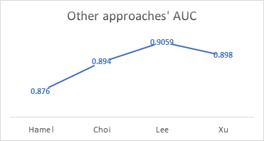
MODELS USED

Slide 22
MODELS USED
Main author | Data description | CNN | RNN | Poolins | Hidden layers | Activation function | Others
Hamel | Mel-spectrum | yes | no | yes | yes | -
Choi | Mel-spectrum | 3-7 | no | yes | no | Sigmoid for the output
Lee | Mel-spectrum normalized | 6 | no | Max-pooling function | - | ReLU activations and a sigmoid for the output | Batch normalization, . Cost function is cross-entropy and in the last convolution layer's output, they applied dropout of 0.5, stochastic gradient descent and a momentum of 0.9. Learning rate decay.
Xu | Spectrogram, raw data and MFB (Mel filter banks feature) with IMD (interaural magnitude differences). Segmenting window. | 2, with 128 filters. | 3 | - | no | 500 ReLU units connected with seven sigmoid output units, one for each class

Slide 23
MODELS USED
Model implemented from the paper -- performed poorly
Another Model: Accuracy: 3%. Structure: DNN, 3 fully connected layers with 2560, 1024 and 41 hidden units, and activation functions being relu, relu and softmax, respectively. Adam optimizer, categorical cross-entropy and MFCC for data.

Slide 24

MODELS USED - BEST MODEL
We used Keras rather than Tensorflow.
1d Convolution
256 Filters
Kernel size of 20
relu activation
stride of 1
Batch Normalization
Max Pooling of 3
Then fed into another 1d Convolution that was the same but for a stride of 3

Slide 25
MODELS USED - BEST MODEL
Bidirectional LSTM
256 Units
tanh activation
Fully Connected layer
173 nodes
relu activation
Batch Normalization
1d Convolution
128 filters
kernel size of 20
stride of 3

Slide 26
MODELS USED - BEST MODEL
Global Average Pooling
Fully connected layer
41 nodes
softmax activation
In total, almost 3.8 million trainable parameters

Slide 27
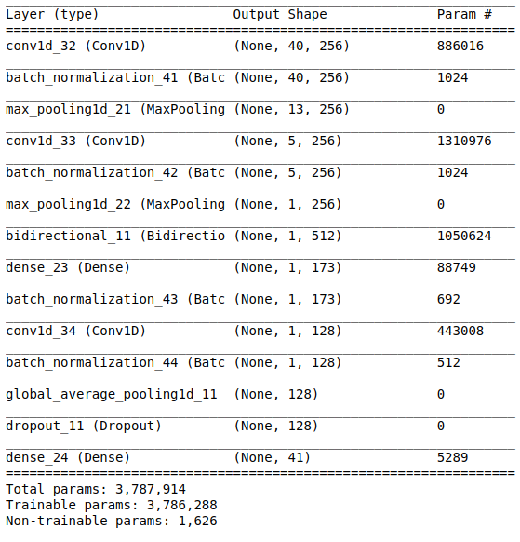
STRUCTURE

Slide 28
RESULTS
After training for 87 Epochs, with batch Size of 75:
Accuracy of 71.4% (considering only top 1 prediction)
Accuracy of 83% (considering top 3 predictions)

Slide 29
THANK YOU =)

